Slide 1
Data Preprocessing
Chapter - 2

Slide 2
Attribute
An attribute is a property or characteristics of an object.
Attribute is also known as variable, field, characteristic, or feature.
A collection of attributes describe an object. Object is also known as record, point, case, sample, entity, or instance.
Example: eye color of a person, temperature.

Slide 3
Types of Attribute In Dataset
Nominal
The values of a nominal attribute are just different names.
Represent category, code or state, also called categorial attribute.
Examples: ID number, eye color.
Ordinal
The values of ordinal attribute provide enough information to order or rank objects.
Examples: street number, grades.

Slide 4
Types of Attribute In Dataset
Interval
For interval attributes, the difference between values are meaningful.
Examples: Calendar dates, temperature in Celsius or Fahrenheit.
Ratio
For ratio variables, both difference and ratios are meaningful.
Examples: mass, age, length.

Slide 5
Dimensional Data
Dimensional data, often referred to as multidimensional data, is a type of data representation used in various fields, including data analysis, business intelligence, and data warehousing.
Dimensional data models are designed to efficiently organize and analyze data with multiple attributes or dimensions.
This approach is particularly useful for understanding complex relationships within the data and facilitating reporting and analysis.

Slide 6
Curse of Dimensionality
The curse of dimensionality refers to various problems and challenges that arise when working with high-dimensional data.
Data Sparsity, Increased Overfitting, Higher Computation Cost
How to avoid it ?
Feature Selection: Carefully select relevant features while discarding irrelevant or redundant ones. Feature selection techniques can help reduce the dimensionality of the data while preserving essential information.

Slide 7
Curse of Dimensionality
Dimensionality Reduction: Use dimensionality reduction techniques like Principal Component Analysis (PCA) to project high-dimensional data into a lower-dimensional space while preserving as much variance or structure as possible.
It is easy to find pattern in 1D or 2D rather than 50D, as the data gets scattered so far apart.
Data Preprocessing: Normalize or scale your data appropriately.

Slide 8
How can Principle Component Analysis (PCA) Be Used For Dimensionality Reduction?
Goal is to find a projection that captures the largest amount of variation in data.
Find the Eigen vectors of the co variance matrix.
The Eigen vectors define the new space.
Construct a neighborhood graph.
For each pair of points in the graph, compute the shortest path distance.

Slide 9
Data Quality & Data Preprocessing
Real world data are highly unprotected from noise, missing, and inconsistent data due to typically huge size and their possible origin from multiple heterogeneous sources.
Low quality data will lead to low quality mining results.
Data Processing is required to handle these facts.

Slide 10
Methods of Data Preprocessing
Data Cleaning
Data Integration
Data Transformation
Data Reduction
Data Discretization

Slide 11
Methods of Data Preprocessing
Data Cleaning:
Mostly concern with:
Fill in missing values
Identify outliers and smooth out noisy data
Correct inconsistent data
Eliminate duplicate data

Slide 12
Methods of Data Preprocessing
Fill in missing values
Missing data may be due to equipment malfunction, data not entered due to misunderstanding.
We can handle it by: Ignore the tuple, fill in missing value manually, use the most probable value, use ta global constant to fill in missing values, use a mean attribute, etc.

Slide 13
Methods of Data Preprocessing
Noisy data
Noisy data is a form of error because of random error in a measured variable.
Data entry problem, Technology limitation
We can handle it by:
Clustering: Detect and remove outliers
Regression: Smooth by fitting the data into regression function
Binning Method: First sort the data and partition into different boundaries with
mean, median values

Slide 14
Methods of Data Preprocessing
Outliers
Outliers are a set of data points that are considerably dissimilar with the remaining data.
Due to change in system behavior, Error in data transmission or transcription
We can handle it by: Model with normality and abnormality. Analogous to supervised learning

Slide 15
Methods of Data Preprocessing
Data Integration:
Combine data from multiple sources into a coherent store.
Problem:
Entity Identification problem
Data Redundancy (same piece of data in multiple place)
Measures:
Using correlation analysis.
Do stepwise and careful integration

Slide 16
Methods of Data Preprocessing
Data Transformation:
Changing data from one form to another form.
Approaches:
Smoothing: Remove noise from data.
Aggregation: Summarization of data. (combining two or more attributes or objects)
Generalization: Hierarchy climbing of data.
Normalization : Scaled to fall within a small specified range. a) Min Max Normalization, b) Z Score Normalization, c) Normalization by decimal scaling

Slide 17
Normalization
1. Min-Max Normalization:
V’ = ((V-min)/(max-min)* (new_max – new_min)) + new_min
2. Z-Score Normalization:
V’ = (V-min)/ stand_dev.
3. Normalization by decimal scaling:
V’= V/ 10j where j is the smallest integer such that max (|V’|) <1

Slide 18
Methods of Data Preprocessing
Data Reduction:
Data reduction is the process of obtaining a reduced representation of data set that is much smaller in volume but yet produces the same or almost same analytical results.
Methods:
1) Sampling: Method for data selection. (simple random sampling, sampling without replacement, sampling with replacement)
Simple Random Sampling: Equal probability of selecting any particular item.
Sampling without replacement: As each item is selected, it is removed from
population.
Sampling with replacement: Objects are not removed from the population as they
are selected from the sample. The same objects can be picked-up more than once.
Stratified Sampling: Split the data into several partitions, then draw random
samples from each partition.

Slide 19
Methods of Data Preprocessing
2) Dimensionality Reduction:
Dimensionality Reduction is about converting data of very high dimensionality into data of much lower dimensionality such that each of the lower dimension conveys much more information.
3) Data Compression

Slide 20
Methods of Data Preprocessing
Data Discretization:
Convert continuous data into discrete data.
Partition data into different classes.
Approaches:
Equal Distance Partitioning : It divides the range into N intervals of equal size. ( W = (A-B)/N )
Equal Frequency Partitioning : It divides the range into N intervals, each containing approximately same number of samples.

Slide 21
OLAP TOOL
OLAP stands for Online Analytical Processing.
An OLAP cube is a data structure that allows fast analysis of data.
OLAP tools were developed to solve multi dimensional data analysis which stores their data in a special multi dimensional format (Data Cube).
Base Cuboid contains all three dimensions
Apex Cuboid refers to the case where the group by is empty.

Slide 22
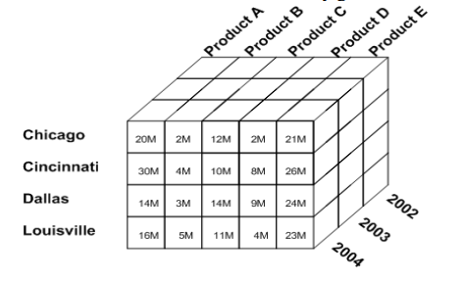
OLAP Operation

Slide 23
OLAP Operation
Slicing:
This enables an analyst to selects a single value for one dimension of the data cube.
Results in a sub-cube E.g. Product A sales
Dicing:
This allows an analyst to selects data from the cube by specifying values for multiple dimensions. E.g. Product A sales in 2004

Slide 24
OLAP Operation
Drill-Down:
This allows analysts to navigate deeper among the dimensions of data. E.g. Product A sales in Chicago in 2004.
Increases level of detail.
Roll Up:
This operation summarizes the data along the dimension. E.g. Total Product.
Reduces detail and shows more general information.

Slide 25
OLAP Operation
Pivoting:
Analysts can gain a new view of data by rotating the data axes of the cube.
Switch rows and columns.

Slide 26
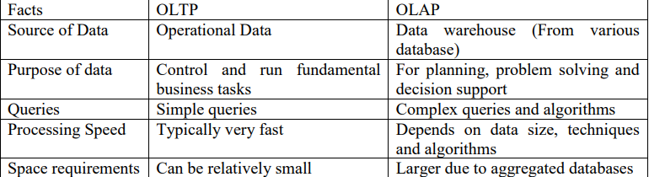
OLAP Vs OLTP

Slide 27
Data Warehousing - Schemas
Schema is a logical description of the entire database.
It includes the name and description of records of all record types including all associated data-items and aggregates.
Much like a database, a data warehouse also requires to
maintain a schema.
A database uses relational model, while a data warehouse uses
Star, Snowflake, and Fact Constellation schema

Slide 28
Star Schema
Each dimension in a star schema is represented with only one-
dimension table.
This dimension table contains the set of attributes.
The following diagram shows the sales data of a company with
respect to the four dimensions, namely time, item, branch, and
location.

Slide 29
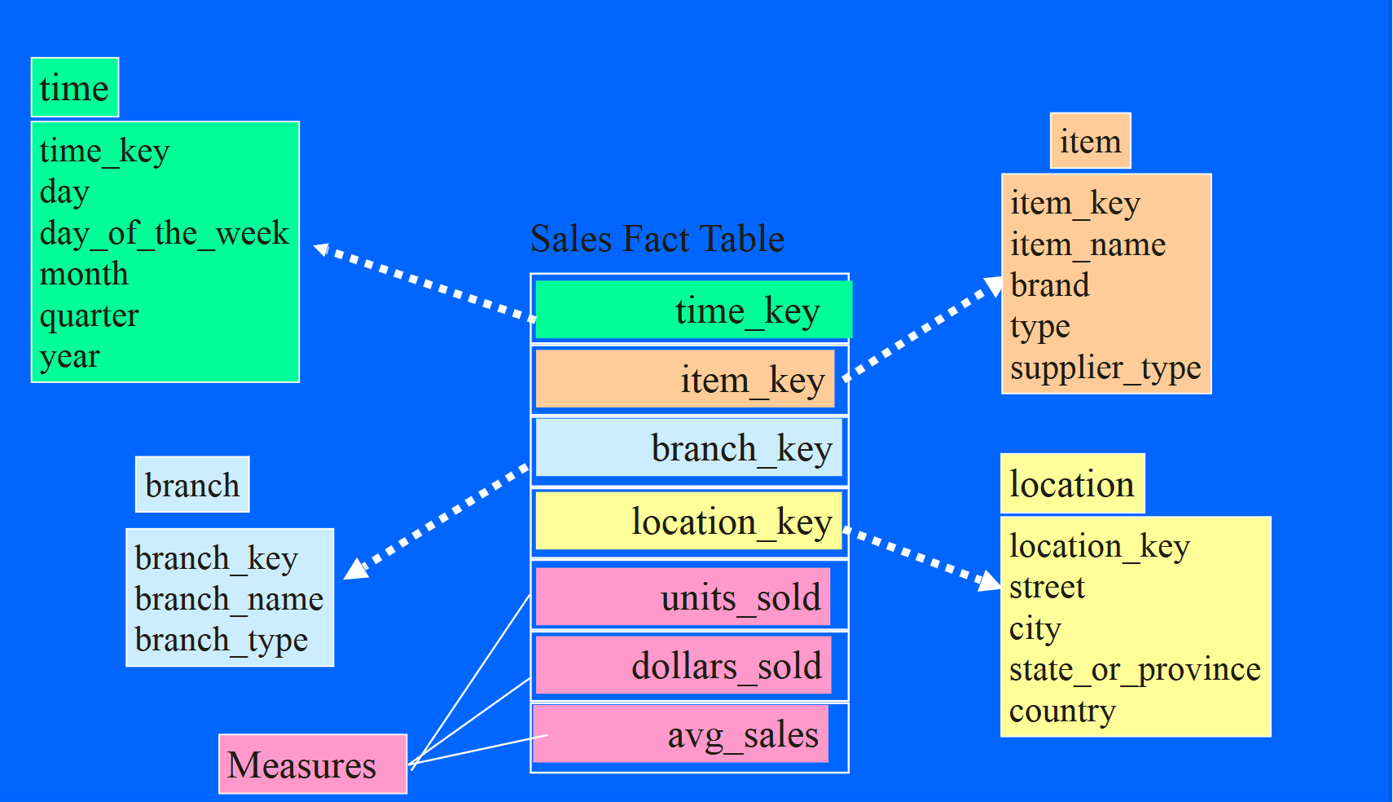
Star Scheme

Slide 30
Snowflake Scheme
Some dimension tables in the Snowflake schema are normalized.
The normalization splits up the data into additional tables.
Unlike Star schema, the dimensions table in a snowflake schema are normalized. For example, the item dimension table in star schema is normalized and split into two dimension tables, namely item and supplier table.

Slide 31
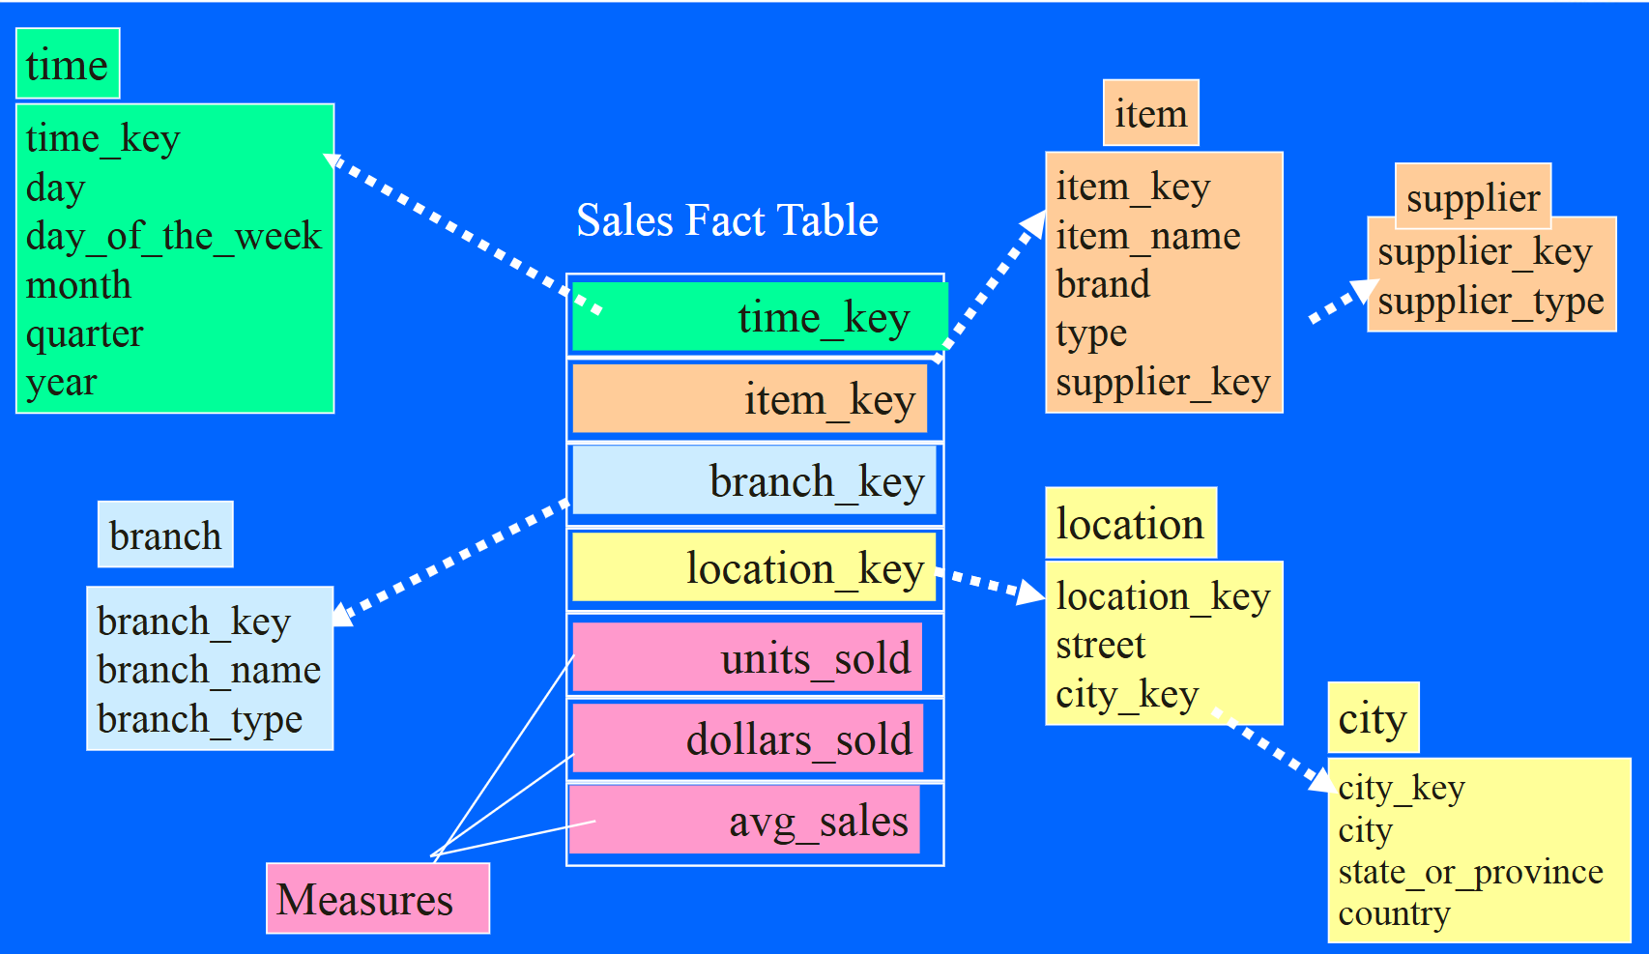
Snowflake Scheme

Slide 32
Fact Constellation Schema
A fact constellation has multiple fact tables. It is also known as
galaxy schema.
The following diagram shows two fact tables, namely sales and
shipping.

Slide 33
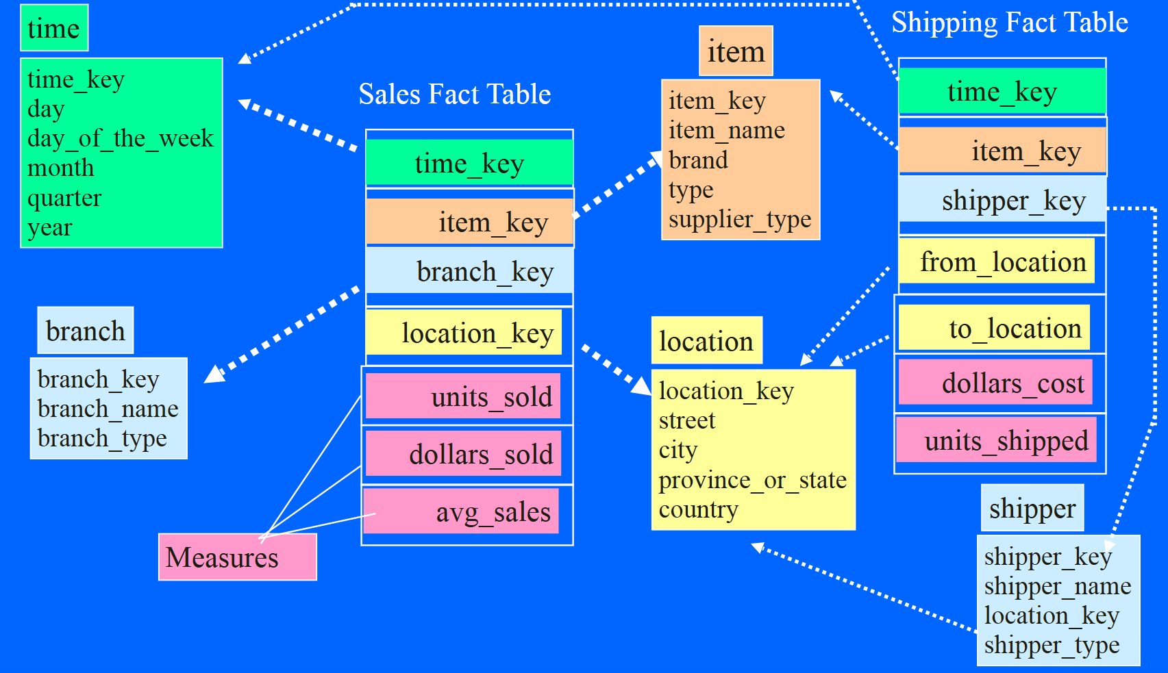
Fact Constellation Schema

Slide 34
Similarity & Dissimilarity
(how close or how far apart data objects are in a dataset)
Similarity:
Numerical measure of how alike two data objects are
0 indicates dissimilar and 1 indicates similar
Use Cases:
Clustering: Group similar items.
Recommendation Systems: Suggest items similar to what the user likes.
Information Retrieval: Rank documents by relevance to a query.

Slide 35
Similarity & Dissimilarity
Dissimilarity:
Numerical measure of how different are two data objects
0 indicates similar 1 indicates dissimilar
Use Cases:
  Anomaly Detection: Find objects that are very dissimilar (outliers).
  Clustering: Separate objects that are far apart.

Slide 36


